Slide 1
Capstone Project
Hotel Booking Analysis
KRISHNA KUMAR VERMA

Slide 2
Content
Importing and loading data of Hotel booking analysis
Data cleaning
Data preparation
Data visualization
Challenges
Conclusion
Suggestions

Slide 3
Data summary
Data set – Hotel booking analysis database includes information about
the hotels booked between the year 2015 to year 2017
Shape:
Rows – 119390
Columns – 32
Important columns- lead time, arrival date, no. of persons, repeated guest,
no. of kids

Slide 4
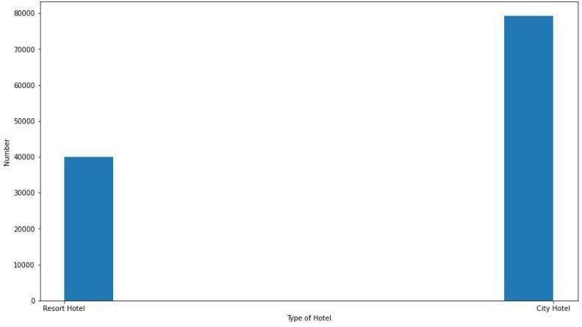
Number of Bookings for various types of hotels

Slide 5
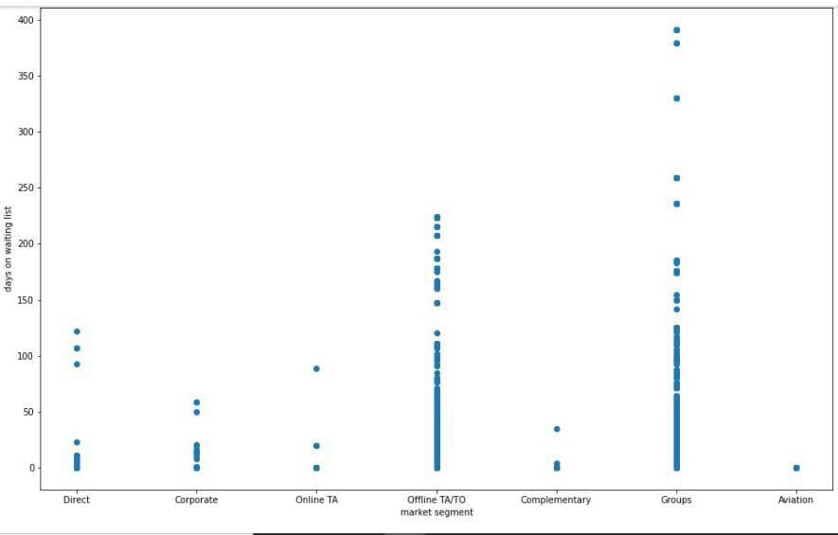
Plot between Type of market segment and Waiting list for the booking

Slide 6
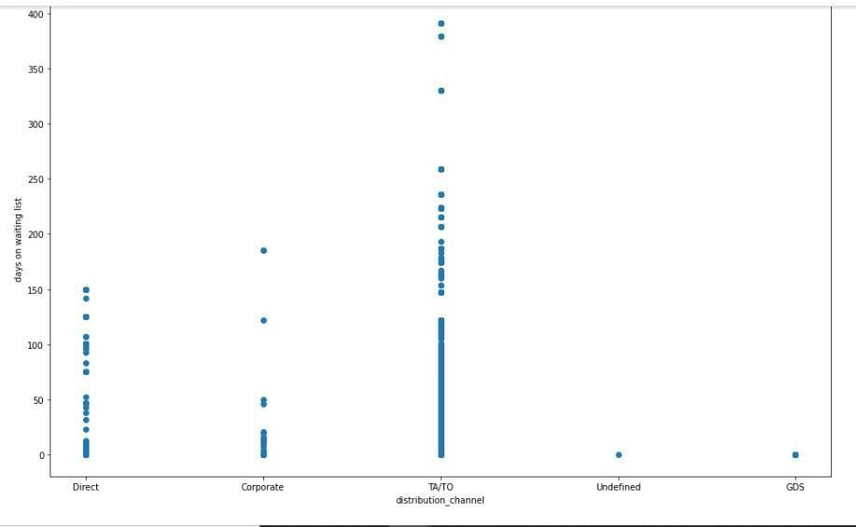
Plot between Distributing Channel and Days on the waiting

Slide 7
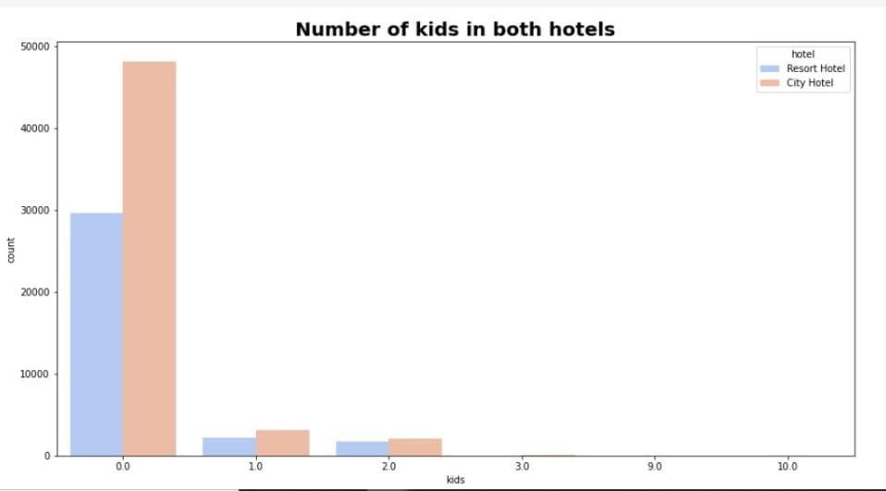
Number of kids in both hotels

Slide 8
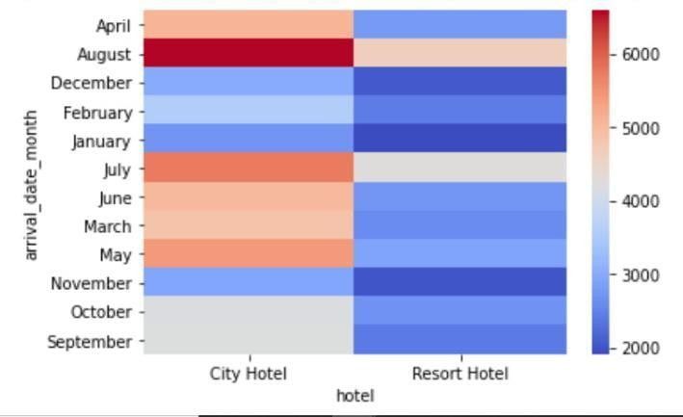
Heatmap between type of Hotel and arrival month

Slide 9
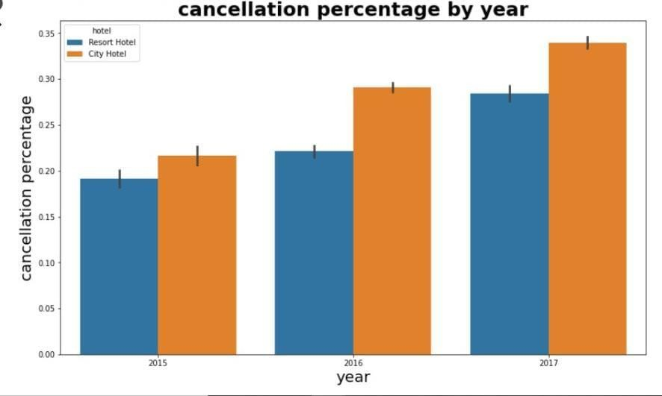
Cancellation percentage by year

Slide 10
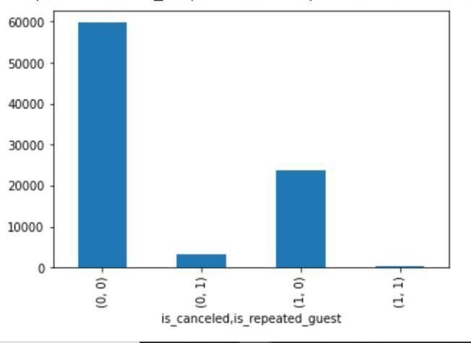
Plot between cancellation type & repeated guest

Slide 11
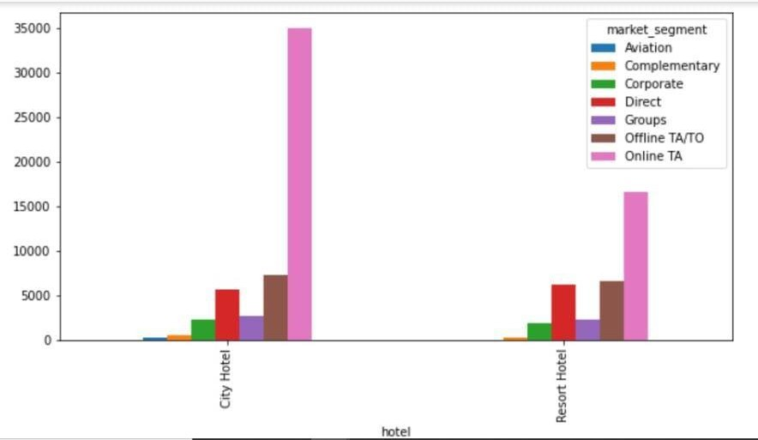
Plot between hotel and market segment

Slide 12
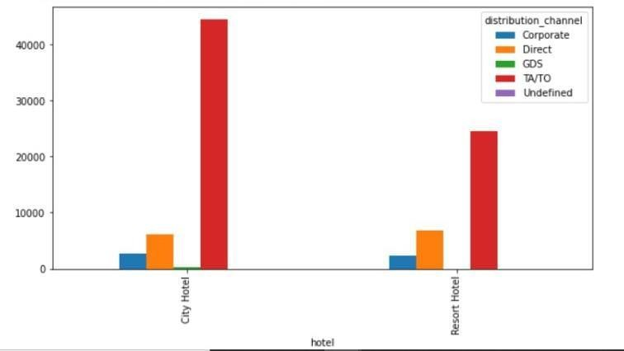
Plot between hotel and distribution channel

Slide 13
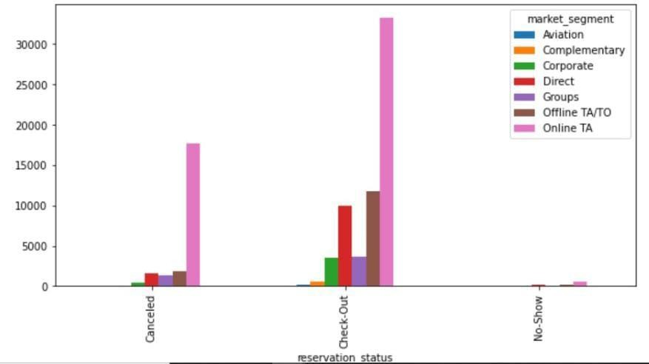
Plot between reservation status and market segment

Slide 14
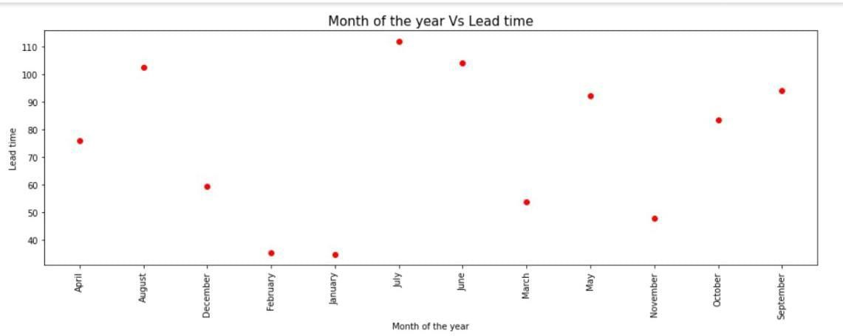
Plot between Month of year & Lead time

Slide 15
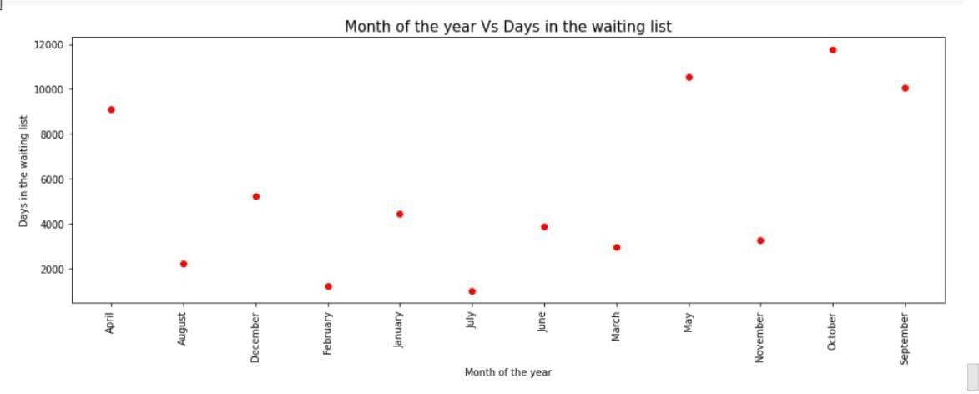
Plot between Month of year & Days in the waiting list

Slide 16
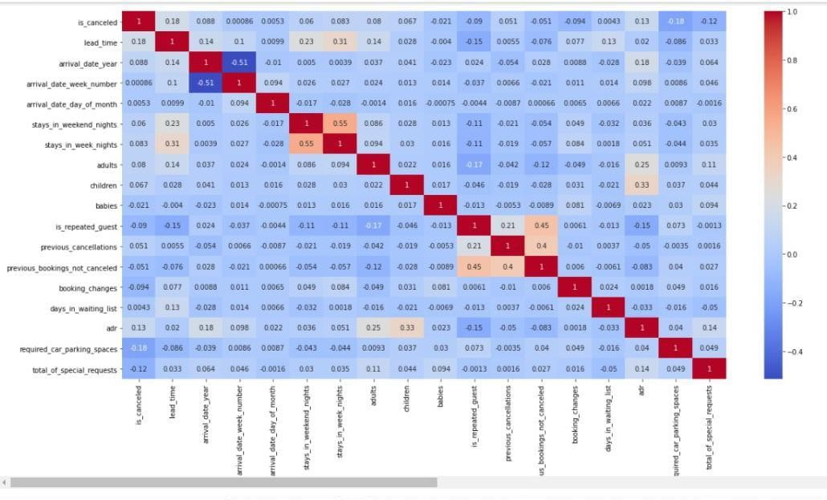
Heatmap - to show the relation between variables

Slide 17
CHALLENGES
The name of the countries was not in the proper format,because of which we are not able to plot the geomap plot
Company and agent column has lots of duplicate value
There were many rows with almost similar data
Lots of null values in the dataset

Slide 18
CONCLUSION
Month of August and july receives most no. of booking.
Booking for city hotels is twice as for resort hotels.
Repeated customers cancel their hotel in very rare cases.
Customers coming from aviation industry has very less time i.e. they book urgently
People with no kid prefer to choose city hotel over resort hotel

Slide 19
Strategies to counter high cancellations at Hotel
Since we see, our repetitive customers are most loyal customers,to maintain them we can provide them with some bonus points,which can be redeem in the next booking
Month of January and December receives less no. of booking,hotels can offer
discounted packages for these months.
Family with kids prefer resorts , we can provide with holiday family packages.
Great no. of the bookings are coming from travel agents, so we can provide them some commission.

Slide 20
Thank You

